Slide 1
Hospital Day Team 1
April 2016
Notes:
Template version: 11/20/2012, for PowerPoint 2007 & 2010

Slide 2

We are trying to build a model that best predicts probability of heart disease
We have access to data from 4 hospitals and about ~1000 patients with 13 key features
Age ?
Sex ?
Chest Pain?
Resting Blood Pressure?
Cholesterol?
Fasting Blood Sugar?
Resting ECG?
Max Heart Rate?
Exercise Angina?
ST Exercise Induced?
Slope?
Number Vessels?
Thal?

Slide 3
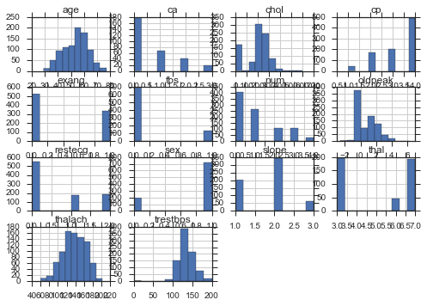
We examined the data for each feature and dropped those that did not have enough data
Additional data cleaning
Heart disease (target) simplified to 0 and 1 (one of the hospitals had 0-4)
Make cholesterol =0 to be NaN
Drop all rows that are NaN

Slide 4
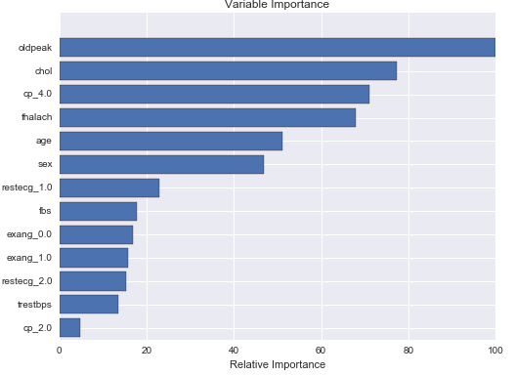
We used Gradient Boosted Ensemble to get a first pass at significant variables

Slide 5
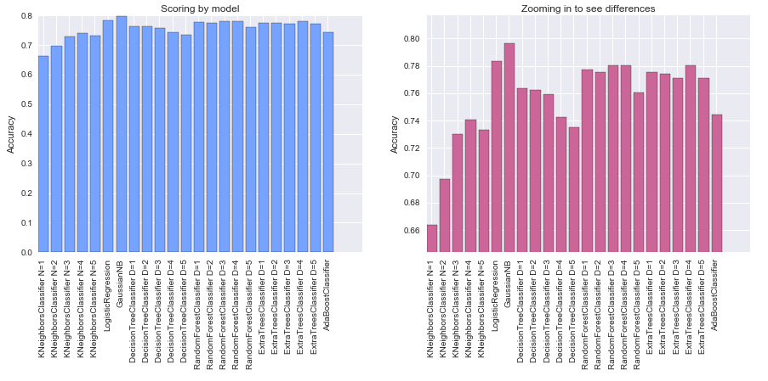
Compared a simplified feature set against multiple models
Scoring: Accuracy
LogisticRegression and GaussianNB score highest

Slide 6
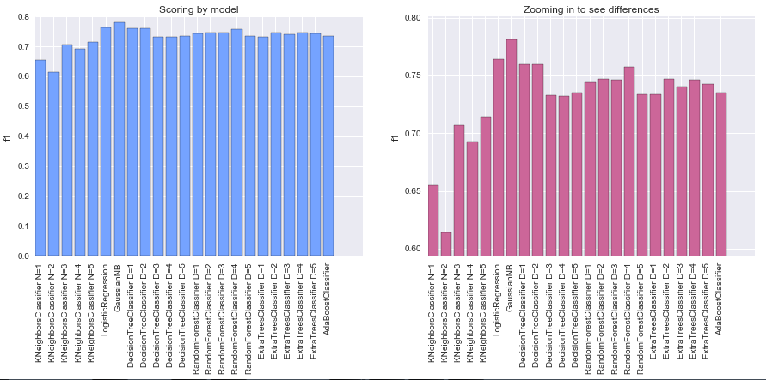
Compared a simplified feature set against multiple models
Scoring: f1
LogisticRegression and GaussianNB score highest

Slide 7
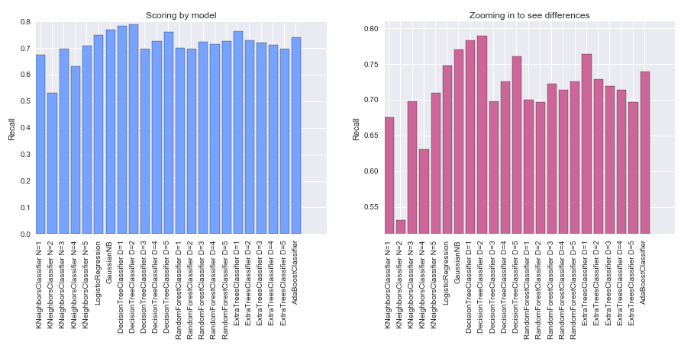
Compared a simplified feature set against multiple models
Scoring: Recall
Decision Tree(depth=2), Gaussian and ExtraTree(depth=1) are highest

Slide 8
We decided to go with Logistic Regression due to high scores (by default) and easier to explain
What we did to tune the model?
Etc.

Slide 9
Our insights

